Slide 1
Cloud Computing

Slide 2
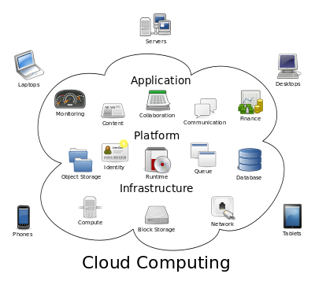

Slide 3
Providers
Google
Amazon
IBM
Oracle Cloud
Rackspace
Salesforce
Zoho
Microsoft Azure

Slide 4
Location based service (LBS) will become a $13B business by 2013

Slide 5
Cloud Computing
Cloud computing involves distributed computing over a network, where a program or application may run on many connected computers at the same time.
Refer to a variety of services available over the Internet that deliver compute functionality on the service provider's infrastructure
Its environment (infrastructure) may actually be hosted on either a grid or utility computing environment, but that doesn't matter to a service user
The data in the cloud, as “Intel inside” (or intelligence inside), is often an important part of the services

Slide 6
Type
Private
dedicated to a single organization
Public
share a computing infrastructure across different users, business units or businesses

Slide 7
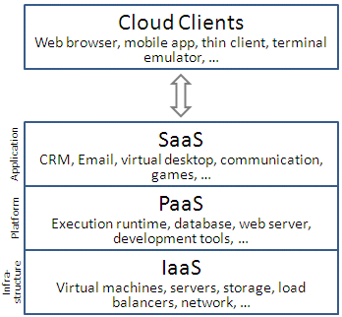
Cloud Computing – Simple Definition
Cloud Computing = Software as a Service + Platform as a Service + Infrastructure as a Service + Data as a Service

Slide 8
Cloud Computing – Simple Definition
Cloud Computing = Software as a Service + Platform as a Service + Infrastructure as a Service + Data as a Service
Software as a Service (SaaS)
From end user’s point of view
Apps are located in the cloud
Software experiences are delivered through the Internet

Slide 9
Cloud Computing – Simple Definition
Cloud Computing = Software as a Service + Platform as a Service + Infrastructure as a Service + Data as a Service
Platform as a Service (PaaS)
From developer’s point of view (i.e. cloud users)
Cloud providers offer an Internet-based platform to developers who want to create services but don't want to build their own cloud
Notes:
Similar to Windows Platform for ISV developers in the PC ecosystem

Slide 10
Cloud Computing – Simple Definition
Cloud Computing = Software as a Service + Platform as a Service + Infrastructure as a Service + Data as a Service
Infrastructure as a Service (IaaS)
Cloud providers build datacenters
Power, scale, hardware, networking, storage, distributed systems, etc
Datacenter as a service
Cloud users rent storage, computation, and maintenance from cloud providers (pay-as-you-go; like utility)
Notes:
Similar to Windows Platform for ISV developers in the PC ecosystem

Slide 11
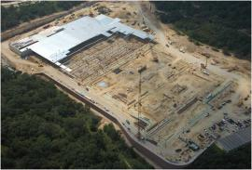
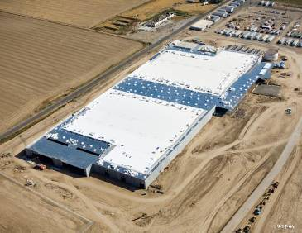
Infrastructure (A mega Datacentre)

Slide 12
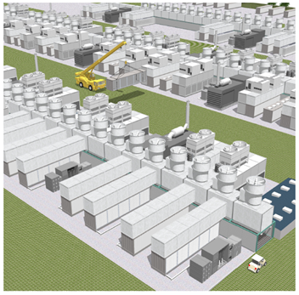
Gen 4 Modular Datacentre
Video links: Microsoft Cloud Computing and Generation 4 Modular Data Centre
Notes:
Microsoft showed how Gen 4 characteristics could be put in place in both the company's smaller data centers and in its mega-data centers. The portion of the video showing off the Gen 4 mega-data center almost looks like a series of interconnected tiny power plants.

Slide 13
Knowledge & Data Intelligence as a Service
Cloud Computing = Software as a Service + Platform as a Service + Infrastructure as a Service + Data as a Service
Data ➔ Information ➔ Knowledge ➔ Intelligence
Infrastructure for Web-scale data mining and knowledge discovery
Empower people with knowledge
Empower applications and services with intelligence

Slide 14
Characteristics
Agility
Application Programming Interface
Cost
Device and Location Independence
Virtualisation
Multi-tenancy
Reliability
Scalability
Performance
Security
Maintenance

Slide 15
Benefits of Cloud Computing
Reduce capital costs
No longer required to make large up-front capital investment on datacenters
Eliminate the need to plan ahead for provisioning
Allow companies to start small and increase their resources investment as needed (pay-as-you-go)
Simplify app deployment & management
Common programming model across mobile, browser, client, server, cloud
Access to strong ecosystem of widely deployed applications
Integration with existing IT assets (Software + Services)

Slide 16
Issues
High operations cost (?)
Data ownership (?)
Changing cloud service providers?
Business failure of cloud providers
Technical/technological issues
Security
Data misuse

Slide 17
Summary
The real underlying value of “cloud + clients” is that it transparently makes software, data, and computing available everywhere.

